Slide 1

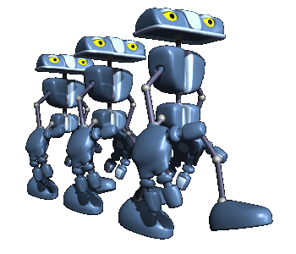
MAD Team Members
SHAWN SEALS
TEJA NALLAMOTHU
MEZEGEBE GEBREYES
MANOHAR NARSUPALLI
Customer: DR. CATHERINE STRINGFELLOW
LUNCH DECIDER

Slide 2
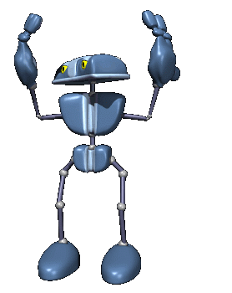
Outline
Overview
Lunch Decider Description
Application Overview
Application Pros and Cons
Life Cycle Model
System Design
Team Organization
Bonus Time
Deployment Issues
Acknowledgements
Demo

Slide 3

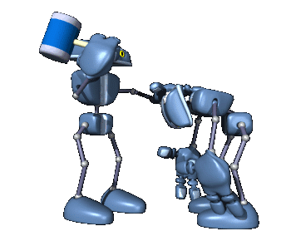
Lunch Decider Description
Provide Google Android smart phone users an entertaining method of selecting a restaurant for dining that meets specific user input criteria.

Slide 4
Application Overview
Android touch screen graphical user interface.
User inputs selection criteria regarding food type, restaurant type, and maximum travel distance.
Restaurants matching user criteria randomly populate a television game show (Plinko) themed GUI control which, when operated, provides an answer in the form of a restaurant name and location.

Slide 5
Functionality Overview
Database Constructor
  Server based.
  Constructs a server based Wichita Falls, TX restaurant database from data gathered using the Google Local Search API.
  Auto update using crontab. Eliminates need for user initiated update.
Obtain User Location.
  Utilize the built in GPS capabilities of phone to obtain users latitude and longitude.
Collect User Input Criteria
  GUI for input of restaurant criteria.
    Food Type (Burgers, Mexican, Pizza, etc.).
    Restaurant Type (Buffet, Fast Food).
    Maximum Driving Distance.

Slide 6
Functionality Overview cont’d
Query Handler
  Server based.
  Receives user input criteria from phone.
  Queries database for matching results.
  Selects “winning” restaurant from matching results.
  Returns “winning” restaurant and 3 “game filler” restaurants to phone.
Display Driving Directions
  Performed only upon user request.
  Google maps driving directions service.

Slide 7
Application Pros and Cons
Pros
  Meets all of the functional requirements that were within our control.
  Very useable. It works!!
Cons
  Violates Google’s TOS.
  Due to limitations of available API’s, we were unable to obtain restaurant cost data.

Slide 8
Life Cycle Model
Agile Model Driven development ( AMDD)
  Modeling few Hours and then coding for few days.
  Why we used?
Still meet your “project planning needs”.
Manage technical risk.
Ask better questioners.
  How well we followed?
We have carried out all the phases of the model in the way as requirements envisioning, architecture envisioning, Planning, Modeling and coding in iterations and finally testing.

Slide 9
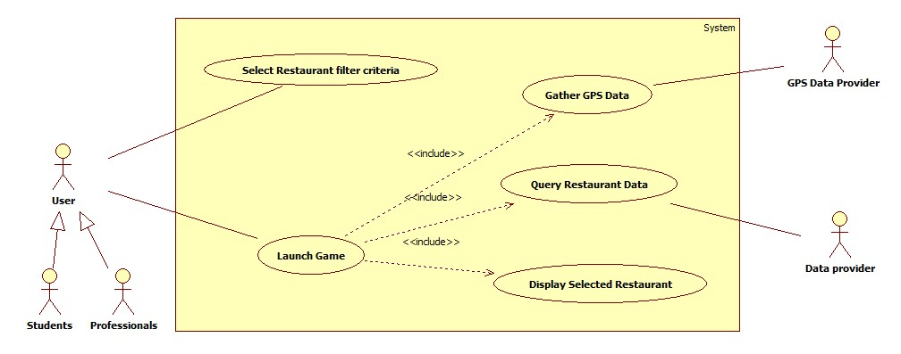
System Design
Use case Diagram for Lunch Decider

Slide 10
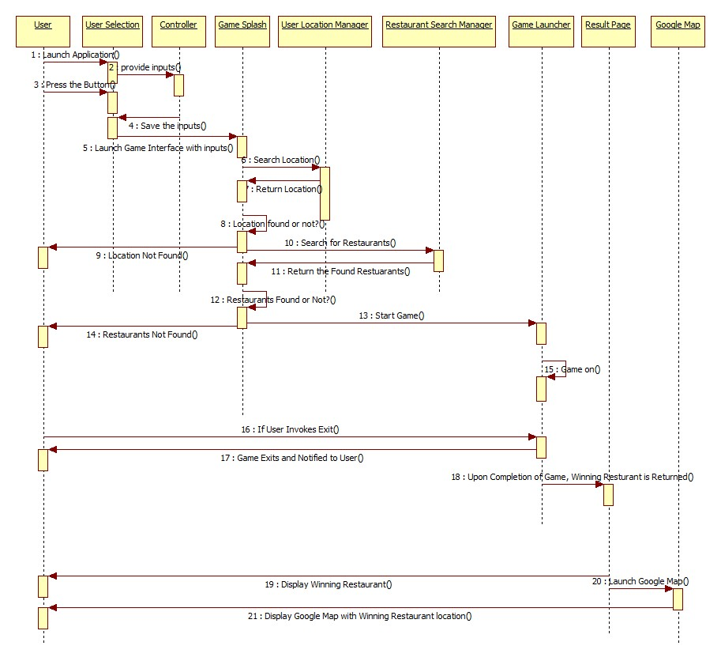
Sequence Diagram for Lunch Decider

Slide 11
Team Organization
  Democratic decentralized (DD): No permanent leader, rather “task coordinator”, decision made by group consensus.
Teja Nallamothu – Co-ordinator, Lead Designer, Tester, Technical Writer
Mezegebe Gebreyes - Lead Developer, Tester, Technical Writer
Shawn Seals Developer – Developer, Lead Animator, Technical Writer
Manohar Narsupalli - Designer, Tester, Technical Writer
How Well we Followed?
  We as a group discussed everything and shared tasks among us.

Slide 12
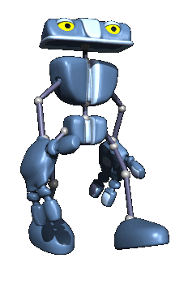
Demo of Lunch Decider

Slide 13
Bonus Time
Sound effects for the game.
Physics based game with user controlled ball drop position.
Improved game graphics.

Slide 14
Deployment Issues
Application has been tested on the emulator only.
GPS module has not been tested using actual GPS signal. Simulated only.
Actual phone operation is unknown.
Possibility that application may not function on all Android phones.

Slide 15
Acknowledgements
Dr. Catherine Stringfellow.
Prof. Terry Griffin.
stackoverflow.com.
Google.
php.net.

Slide 16
Questions???

